Slide 1
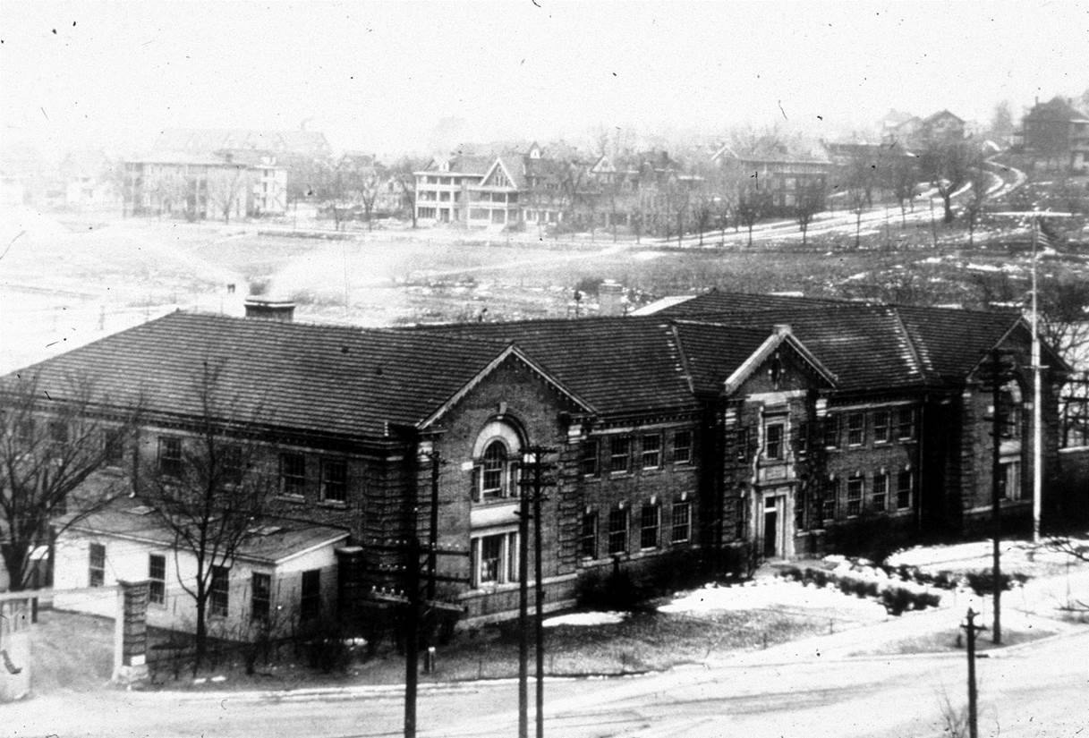
Forest Products Utilization and Marketing Historical Perspective
Rusty Dramm, FPL
Forest Products Laboratory
circa 1920

Slide 2
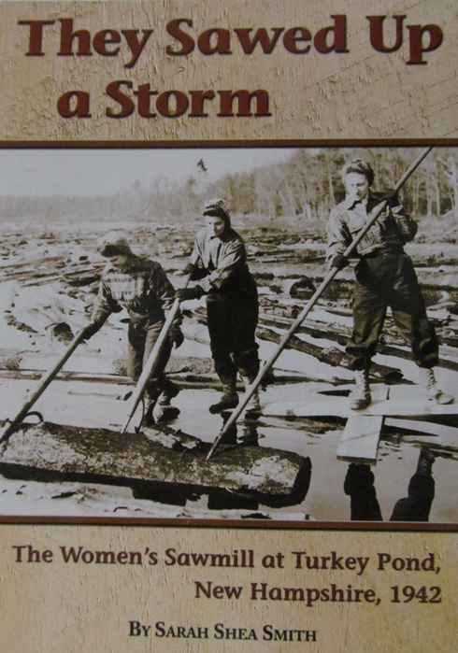
1938 Nor’easter Hurricane
Northeast Timber Salvage Administration
The first time the USDA Forest Service provided sawmill technical assistance
4 billion board feet of timber blown down in New England
Forest Service prevented log market collapse by controlling release of salvaged timber and logs
Forest Service built log ponds to store salvaged logs
Forest Service built and ran sawmills to salvage logs

Slide 3
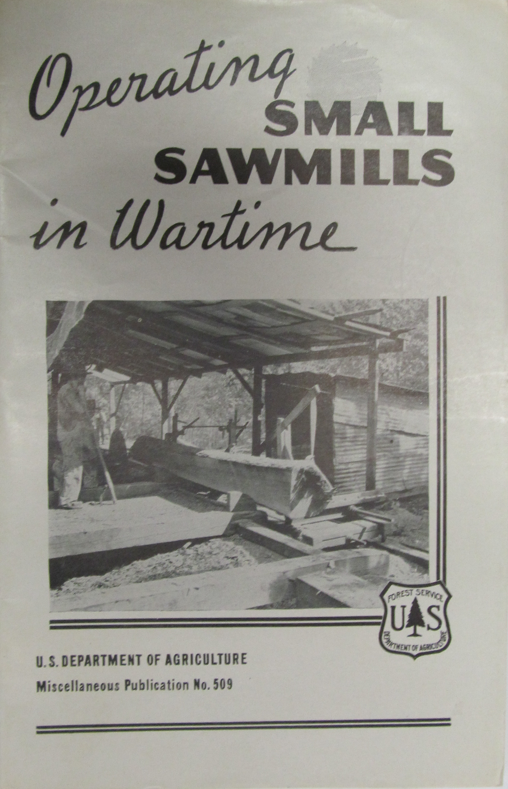
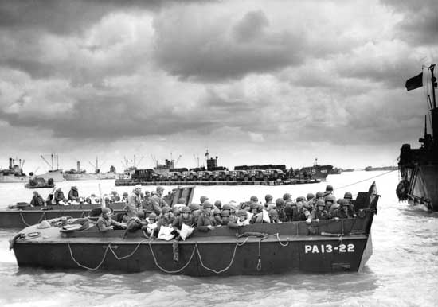
Timber Production War Project
FPL and War Production Board – WWII
British Mosquito Bomber
Higgins Landing Craft

Slide 4
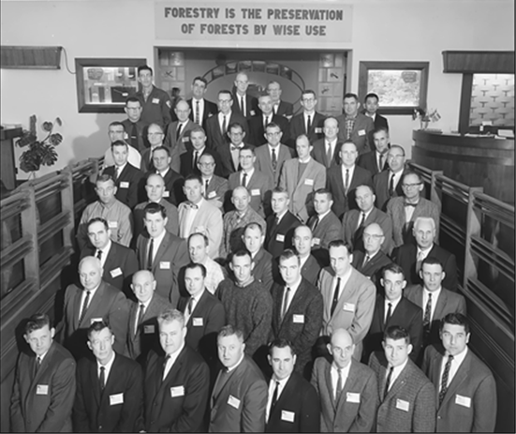
Forest Utilization Service (FUS)
1946–67 USDA Forest Service – FPL with FS Research & Development provided forest
products technical assistance, technology transfer and industrial development services

Slide 5
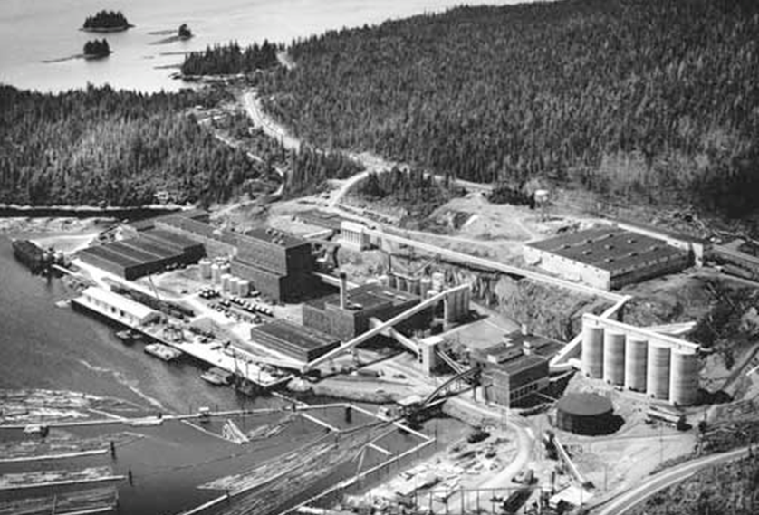
FUS Forest Development Projects
Two Alaskan Dissolving Pulp Mills
FS 50-year timber contracts to support pulp mill investments
Photograph courtesy Ketchikan Pulp Company, 1954

Slide 6
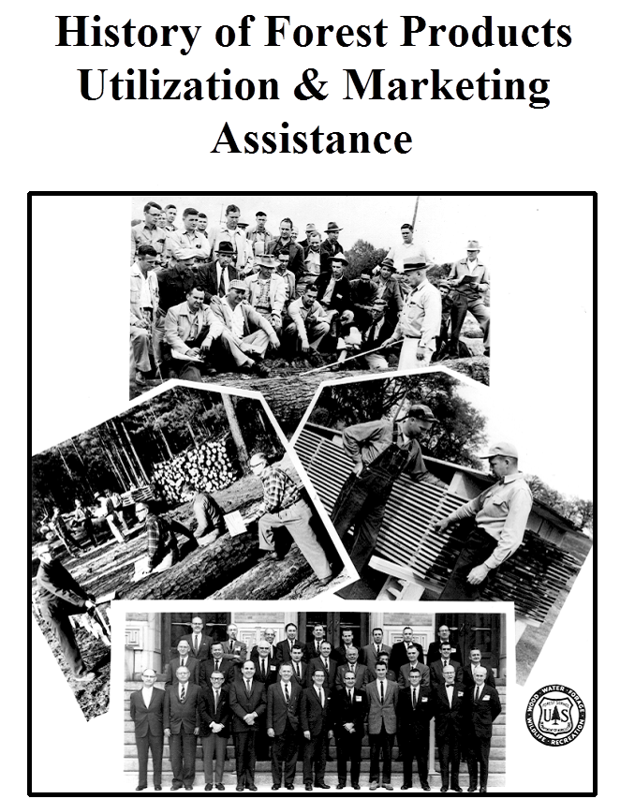
6-Week U&M Boot Camp
In 1967, technology transfer and technical assistance responsibilities passed from Forest Service R&D to S&PF Cooperative Forestry under the new Forest Products Utilization (FPU) program

Slide 7
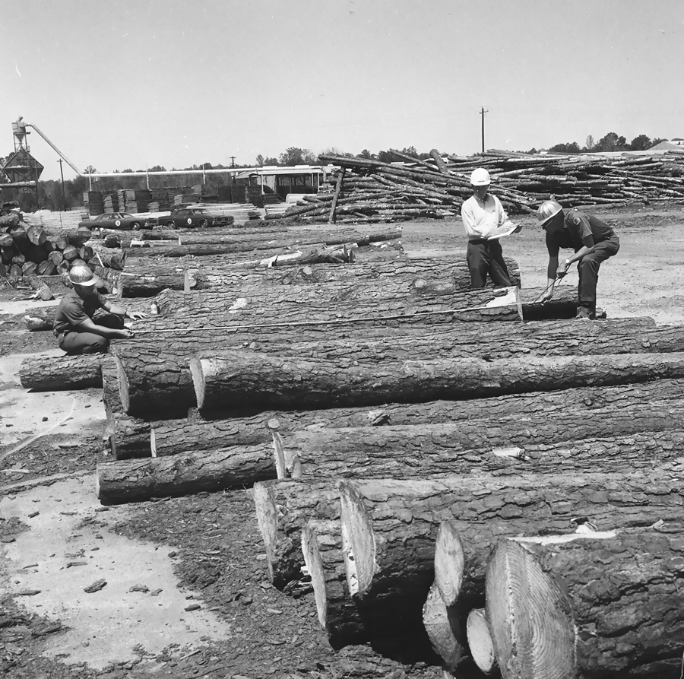
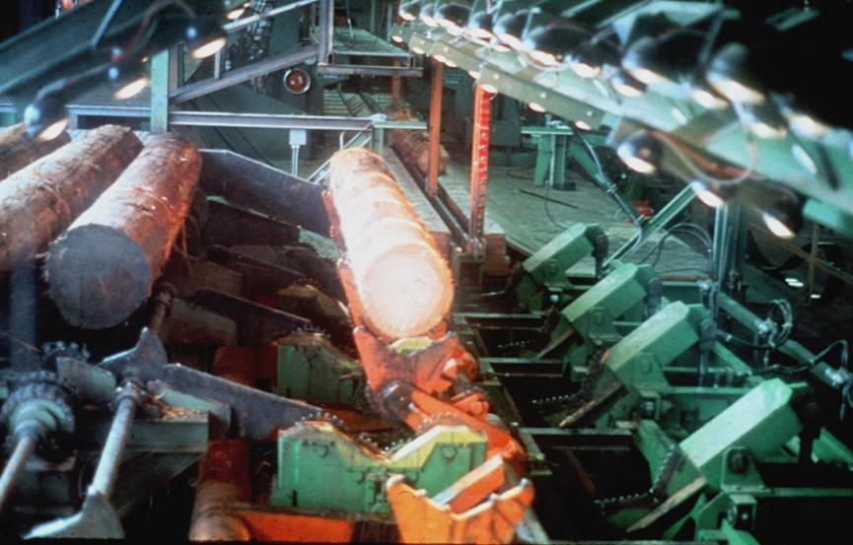
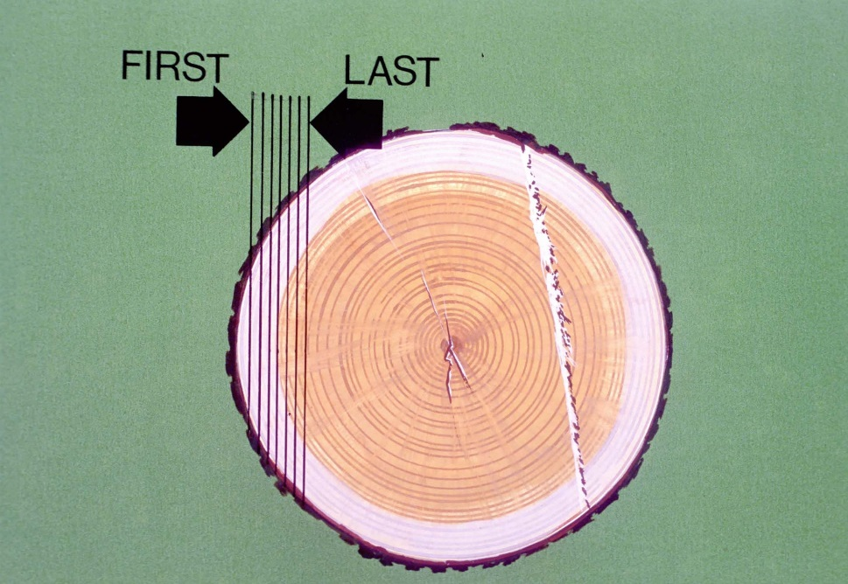
1970s – S&PF Unit at the Forest Products Laboratory
Integration into Sawmill Optimization 1980s
The first industrial application of Best Opening Face (BOF) integrated with log scanning and computer optimization control technology at Willamina Lumber Company, Willamina, OR
Sawmill Improvement Program (SIP)
successful technology transfer of BOF with SIP studies conducted by State Forestry U&M Specialists. National Wood Products Extension provided outreach and education to industry
FPL’s Best Opening Face (BOF) computer sawing optimization

Slide 8
Sawmill Improvement Program (1973-1985)
BOF is the basis for today’s sawmill computer optimization technology
Improve conversion efficiency
2,000+ SIP studies conducted
4% national improvement
Over 1 billion bd. ft. conserved annually – enough wood to build all the houses in Madison each year

Slide 9
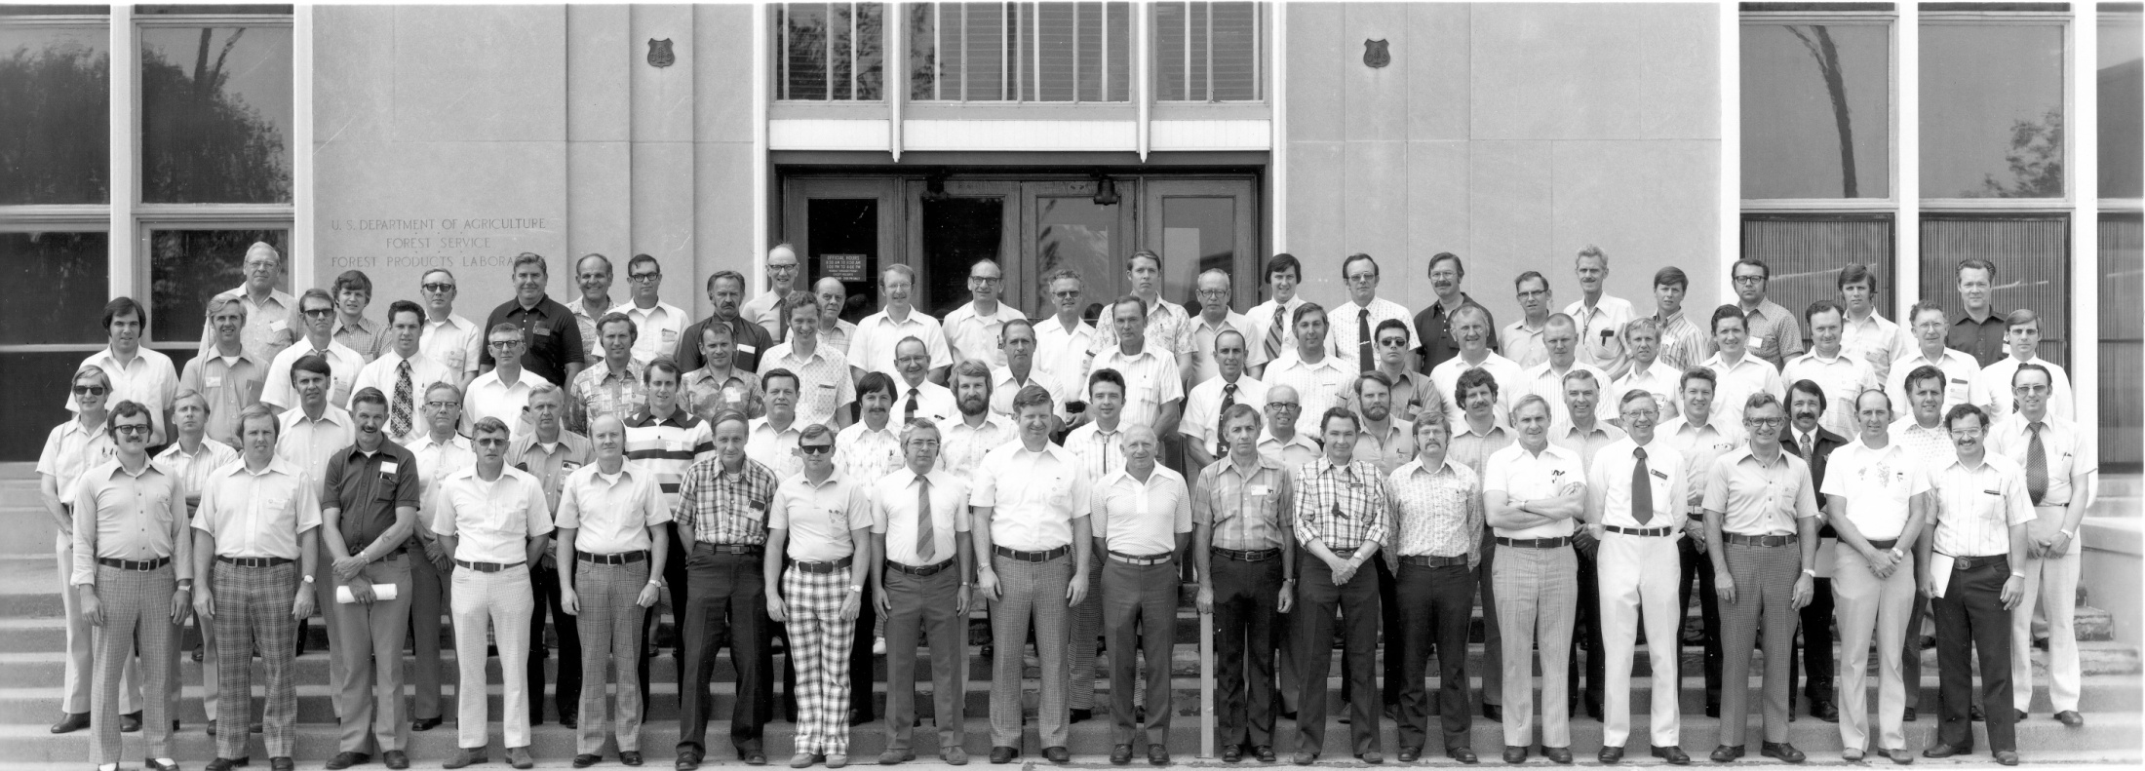
National U&M Meeting at FPL Sawmill Improvement Program (1973-85)
USDA Forest Service, State Forestry and Extension Sawmilling Efficiency Specialists

Slide 10
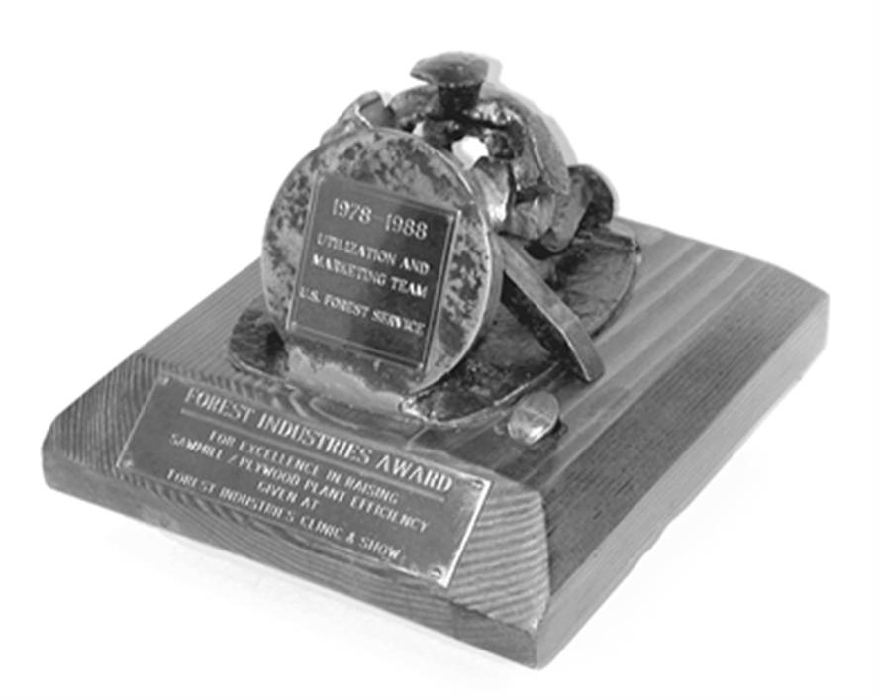
Forest Industries Award presented to US Forest Service
Utilization and Marketing Team
…for Excellence in raising Sawmill and Plywood plant efficiency
Given at the 1992 Forest Industries Clinic and Show

Slide 11
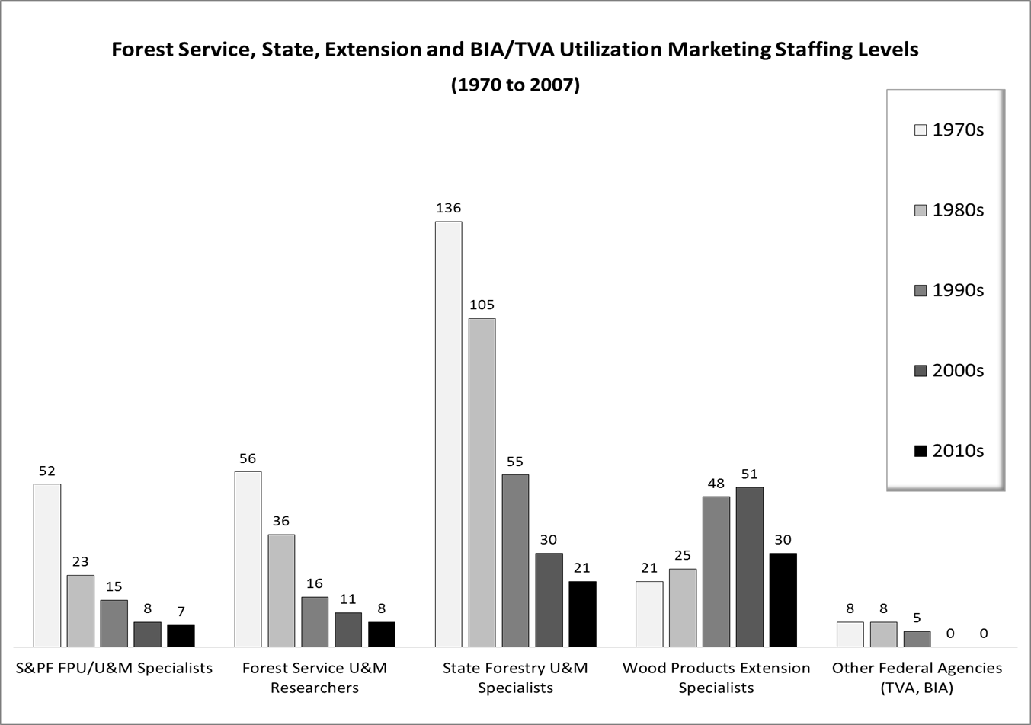
Dramm 2007

Slide 12
Community
Sustainability
Environment
Economy
Dramm, LeVan and Sebelius 2005

Slide 13
Forest Products Utilization and Marketing Goal
Provide forest products utilization and marketing assistance for restoring, managing and improving our nation’s forests while enhancing communities and economies – sustainability defined
2014 Hazardous Fuels Woody Biomass Utilization and Marketing Planning Summit
Kemp Natural Resources Station Meeting, University of Wisconsin—Madison, Minocqua, WI

Slide 14
Forest Products Utilization and Marketing Objectives
Provide new and expanded utilization and marketing opportunities of products and residues
Strengthen technology development and application with program delivery partners
“Be Relevant” or else…
“Find a need…and fill it!”
Facilitate cooperative working relationships

Slide 15
What do we focus on? Questions the Forest Service Keeps in Mind
Do we have authorities to proceed? – enabling Federal legislation and appropriated dollars
Is the project relevant? – what objective(s) will be met?
Is this an appropriate project? – how does it support and advance the USDA Forest Service Mission?
What is the priority and how is this determined?
Critical Factors for Success – Is the project feasible?
Do we have the technical expertise to pull this off?
Is there adequate funding sources?
Do we have top management support?

Slide 16
Critical Factors for Success* Due Diligence
Raw material resource availability
Product options for the available resource
Market feasibility and marketing plan
Processing/manufacturing technology
Business management “know how”
Financial feasibility, available financing
Environmental, health & safety concerns
Social license – will they let you do this?
* Step-by-step process of objective evaluation of sustainable forest products opportunities based on forest products industrial development procedures to avoid subjective “I think this…I think that” opinions

Slide 17
Working Across Boundaries for Utilization and Marketing

Slide 18
Working Across Boundaries for Utilization and Marketing
USDA Forest Service (FPL, FPMU, Cooperative Forestry) works with partners for program delivery
State Forestry Utilization and Marketing Specialists
Wood Products Extension – Wood Innovation Centers
NGOs – US Endowment for Forests and Communities (Carlton Owen, Michael Goergen), Forest Business Network (Craig Rawlings), WoodWorks (Jennifer Covers)
Consultants – Don Peterson, Wilson Engineering
Forest products industry collaborators – Vaagen Bros.
Many others – forest dependent communities, tribes…

Slide 19
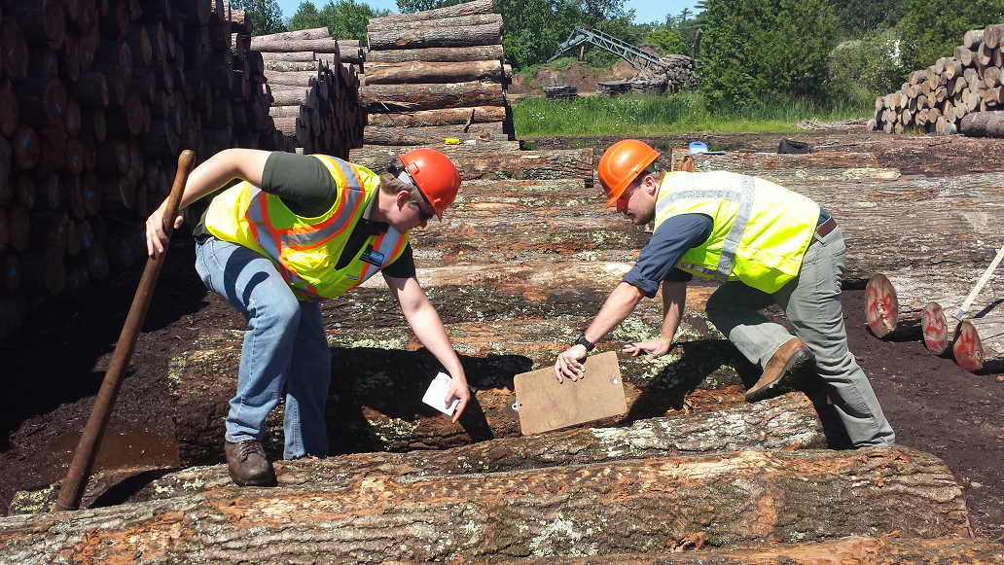
How can we collaborate, share expertise
and resources with our U&M partners?

Slide 20
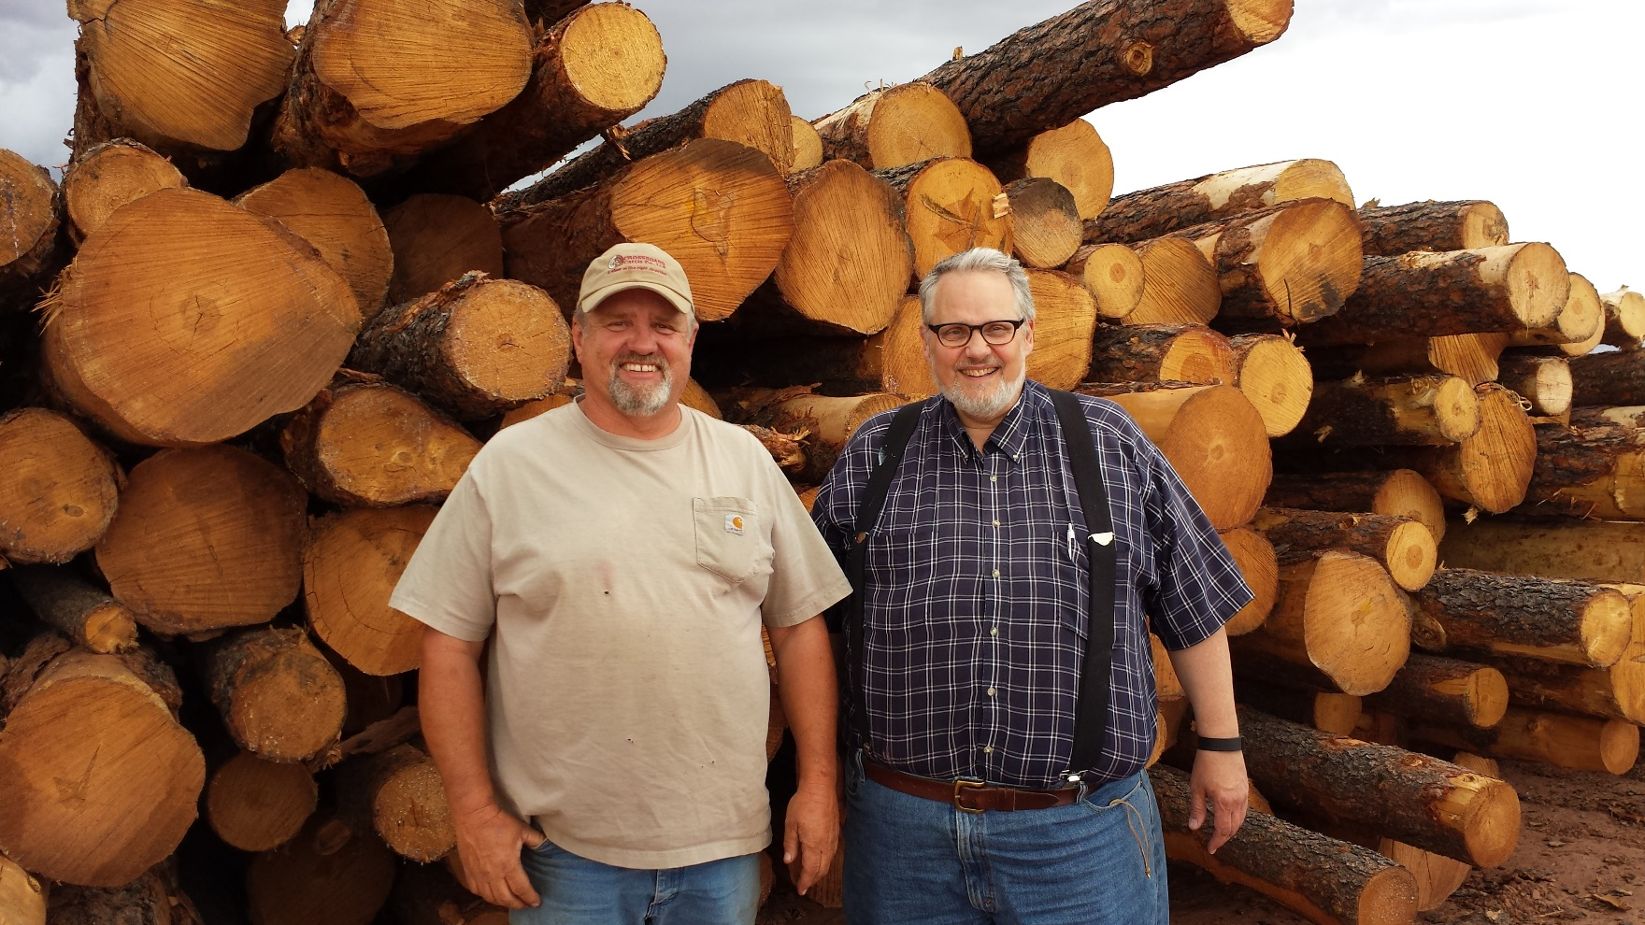
How should we respond to U&M Technical Assistance Requests?

Slide 21
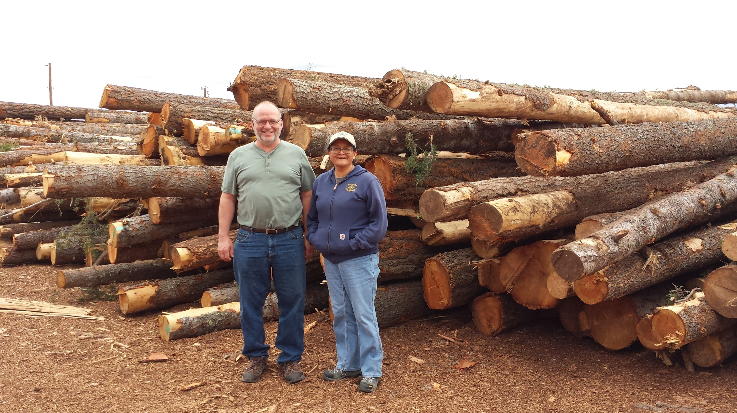
Who are the important partners to
bring in on technical assistance?

Slide 22
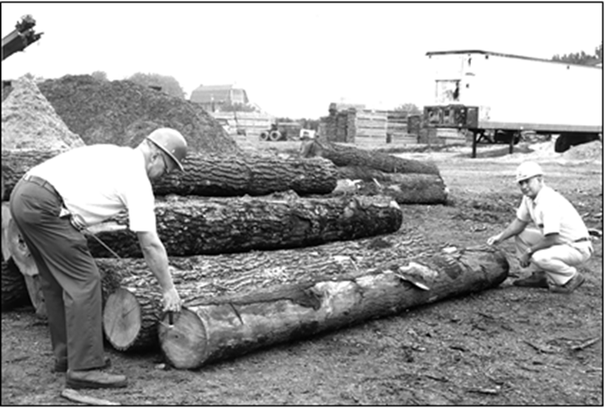
How do we curb loss of Forest Products Utilization and Marketing technical assistance capacity and expertise?
Jim Whipple, Wisconsin DNR Kent McDonald, FPL

Slide 23
Questions

