Slide 1
Welcome to Wisconsin!
WI DNR Forest Products Services – Scott Lyon
Sustainable Resources Institute – Don Peterson
University of Wisconsin Extension – Scott Bowe

Slide 2
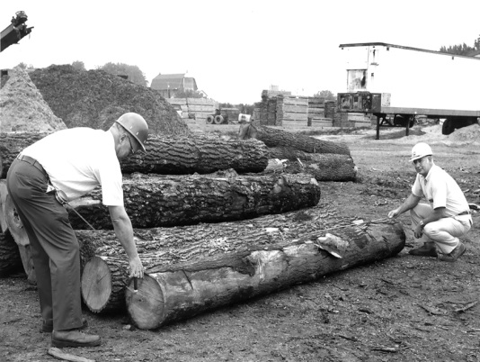
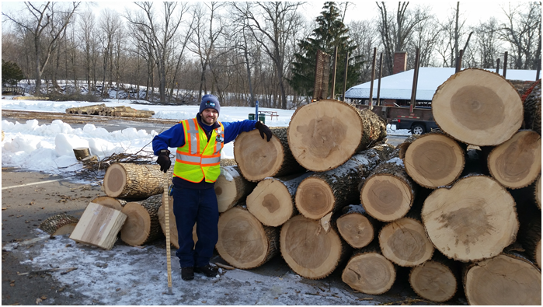
Our Program
Four Forest Products Specialists:
  Scott Lyon (Green Bay)
  Sabina Dhungana (Madison)
  Vacant (Rhinelander)
  Vacant (Hayward/Spooner)
Forest Inventory & Analysis Crew
  Vacant (Madison)
Forest Economist
  Vacant (Madison)
Team Leader
  Collin Buntrock (Rhinelander)
Don Peterson - WWMT
Scott Bowe - UWEX

Slide 3
Key customer groups
Wood-using businesses (~1,200 statewide)
Support businesses (forestry & logging)
County economic development groups
Industry associations
Technical colleges
Other state agencies (e.g. DATCP, WEDC)
WI DNR Division staff (policy and information)
Lake States Lumber Association
Great Lakes Timber Professional’s Association

Slide 4
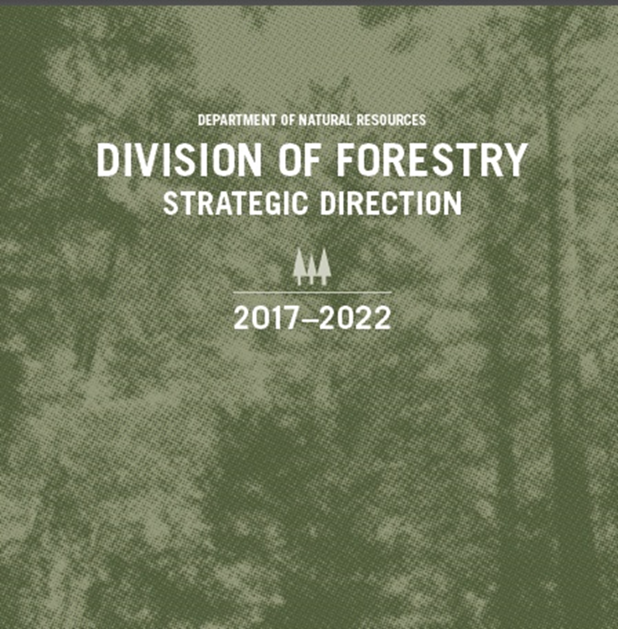
Area of Focus
Better utilization of hard-to-market species
Awareness of careers in the primary and secondary forest industries
Understanding of WI DNR regarding industry needs
Technical assistance
LSLA Education Inc.

Slide 5
What changes have been made in program in the past 5 years?
WI DNR Strategic Direction
Hiring: 2 new forest products staff, Forest inventory analyst and forest economist
How has your clientele base changes since the Great Recession:
  Companies expanding into international markets
  Pulp and paper more volatile
  Increase in utilization of urban wood
  Dealing with invasives

Slide 6
What changes have been made in program in the past 5 years?
Changes planned for next 5 years: UW Extension integration into UW-Madison
New hires? UWEX None planned
Retirements? None planned
How has your clientele base changes since the Great Recession: More consolidated, but significant recovery.

Slide 7
What expertise are you missing that is most often asked for?
How do you fulfill those requests now?
  Stumpage pricing
    Have landowners contact mills/loggers for local pricing
  Company siting and recruitment
    Provide resource and market analysis.
    But not actively recruiting for companies
  New product/expanded markets for WI species (pulpwood, small diameter logs, big diameter Eastern white pine!!!)

Slide 8
Top 3 to 5 most common requests (FAQs)
Buyer/supplier listings
Species uses and product markets- big diameter softwood (ie EWP)
Wood processing related questions- (ie. Kiln drying, sawing, scaling)
Forestry resources supply data (ie. FIA, forestry industry and trends)
More basic – hardwood lumber grading
Sawing, Edging, and Trimming
Kiln Drying

Slide 9
What are your strengths?
Traditional U and M
  Wood manufacturing/processing
    Hardwood Lumber Grading
    Sawing, Edging, and Trimming
    Kiln Drying
  Buyer/supplier connection
  Customized business development
International marketing of wood products
Networks
  Fostering awareness of the importance of markets for forest management

Slide 10
Describe the 3 biggest challenges facing your program
WI DNR
  General misunderstanding of our services from departmental foresters
  Technical training for staff
UWEX
  Loss of basic funding for travel and supplies
  I can find project funding, but it limits how I can spend for travel
  Loss of Bob Govett at UW-Stevens Point
SRI

Slide 11
Describe the 3 biggest opportunities for your program
Building connections with industry
Marketing our industry and forest resource
Open for new products and tech transfer
We have great partners:
  Lake States Lumber Association
  Great Lakes Kiln Drying Association
  Great Lakes Timber Professionals Association
  Rusty Dramm at FPL

Slide 12
Describe the 3 biggest opportunities for your program
SRI
  Master Logger FSC COC
  Master Stewardship Agreement (Region 9)
  MI and WI Master Logger Certification
  Safety and Woods Worker Training (SAWW)
  Scrub Oak Restoration on the Florence County Forest
  Sustainable Forest Resource Management Group (FSC Public and Private Landowner Group)
  Wetland Delineation and Forest Management
  Wisconsin Urban Wood
  Urban Wood Network
RRS:
  Kenosha County Urban Mechanized Tree Removal
  LSLA Administration (10/1)
  Wisconsin Wood Marketing Team

Slide 13
Questions or Comments?

