Slide 1
University of Minnesota Extension
Mike Reichenbach, Regional Extension Educator

Slide 2
Minnesota Forestry Extension
7.5 FTE
4, Specialists
2, Program Coordinators
4, Regional educators
0, County-based
Landowners
Natural Resource Professionals
Logging Business Owners
Communities
Notes:
Forest Health
Urban Forestry
Forest Invasive Species
Agroforestry and Bio-energy
Funding sources:
Federal, State
Program Income
Grants
Contracts

Slide 3
What Change Do we expect?
Expansion of program coordinator position(s)
Local Extension Educator, hybrid poplar and the emerging bio-economy
Local Extension Educator, County position

Slide 4
How do we do Wood Products
Referral
University of Minnesota Natural Resource Research Institute
Minnesota Department of Natural Resources
USDA-FS
Economic Development Organizations
Minnesota Logger Education Program
Minnesota State Wood Innovation Team
Sustainable Forest Education Cooperative

Slide 5
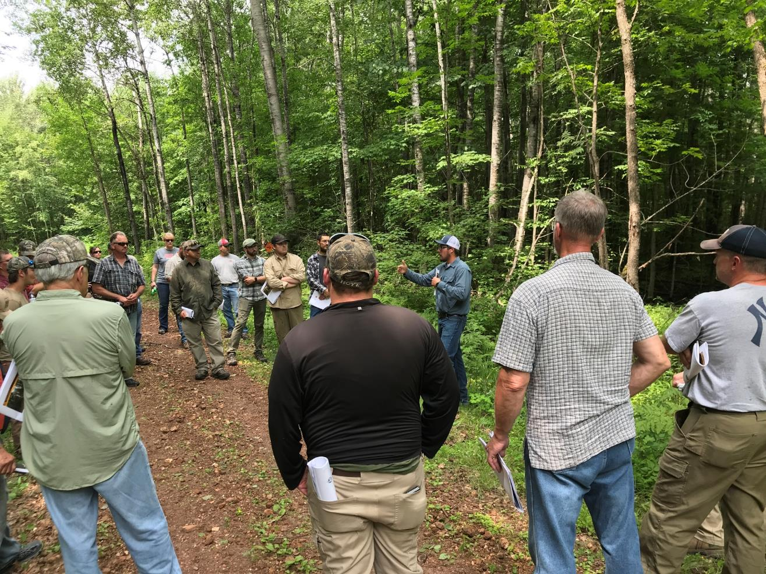
Sustainable Forest Education Cooperative
Darin Erickson UPM – Blandin Paper Company teaching forest road construction.
Industry/MLEP/University collaboration and professional development.

Slide 6
Wood use and areas of interest
Fire risk and use of low value species/loss of biomass plants
Retention of existing logging infrastructure
Retention and expansion of existing primary and secondary manufacturing
Bioproducts

Slide 7
Minnesota Extension Forestry Strengths
Master Woodland Owner
Silvopasture
Land Transfer
Forest Invasive Species
Professional and Logger Education
Sustainable Forests Education Cooperative
Notes:
SFEC programming the targets professionals. Especially silviculture and forest management, including production-oriented management.
Related to your theme that growth can be done, we have seen major growth in program delivery, attendance, and program fee revenue through SFEC over the past year

Slide 8
Master Woodland Owner courses
2016 |  |  |  | 2017 |  |  |  | 2018 |  |  |  | 2019
Spring | Summer | Fall | Winter | Spring | Summer | Fall | Winter | Spring | Summer | Fall | Winter | Spring
BIG WOODS, BIG RIVERS (Rochester, MN, 9 participants)
 |  |  |  | METRO (St. Paul, MN; 17 participants)
 |  |  |  |  | LAURENTIAN (Virginia, MN; 31 participants)
 |  |  |  |  | NORTH SHORE (Two Harbors, MN; 25 participants)
 |  |  |  |  |  |  |  | CENTRAL LAKES (Brainerd, MN; 13 participants)
 |  |  |  |  |  |  |  |  |  | ST. CROIX-KETTLE RIVER (Sandstone, MN;10 participants)

Slide 9
Addressing Challenges
Fixed or declining Federal and State support
It can be done!
Capacity
Focus on fewer things
Program coordinators
Expand reach through online offerings and social media
Notes:
Growth can be done, SFEC has seen major growth in program delivery, attendance, and program fee revenue over the past year
Focus on where we want to be. – Develop a vision
Meet/communicate often
Keep focused on the game plan - strategy

Slide 10
Increased emphasis
Forest Invasive Species
Silvopasture
Volunteer component for the Master Woodland Owner Program
Online learning to engage larger numbers of landowners
Broader use of social media

