Slide 1
College of Natural Resources and Environment
Department of Sustainable Biomaterials
Bob Smith

Slide 2
Natural Resource Extension Focus Areas
Enhancing ecosystem integrity, sustainability, and stewardship;
Improve natural resource industry and community viability; (wood products program)
Improve natural resource decision making capacity in stakeholders (youth, gov. leaders, volunteers, natural resource professionals, educators).

Slide 3
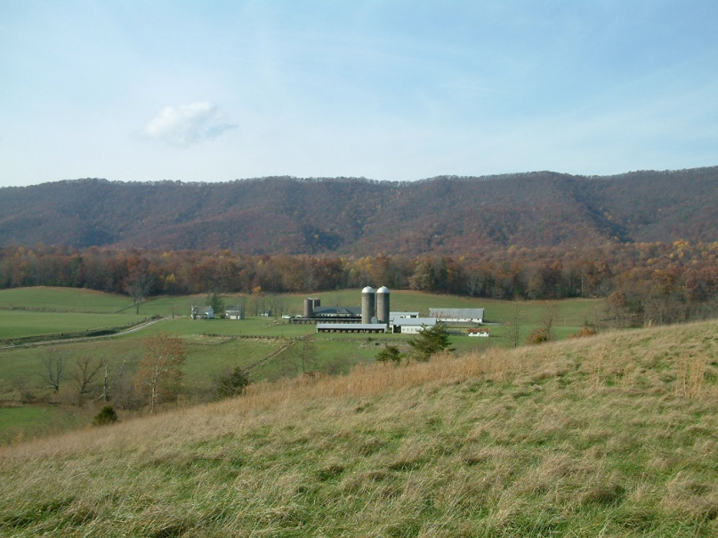
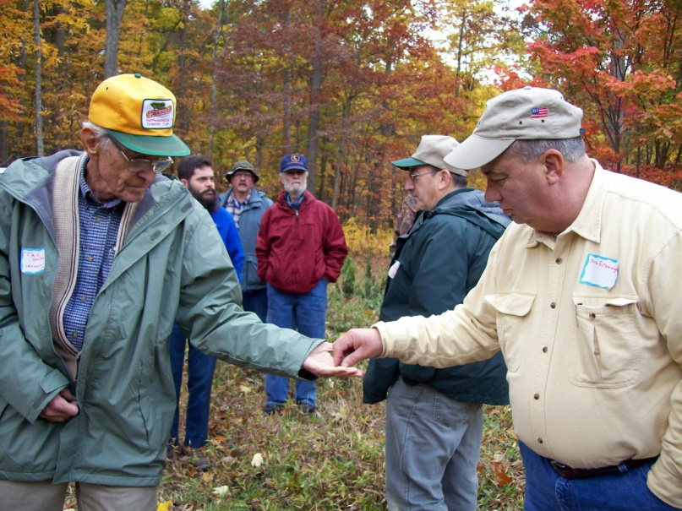
Natural Resource Programming
Forestry provides $20+ billion annually to Virginia’s economy
Non-industrial private landowners own 66% of Virginia’s forestland (10.1 million acres ~ 384,000 owners)
Educating non-industrial private forest landowners about sustainable forestry practices is essential for maintaining a healthy and productive forest land base in Virginia

Slide 4
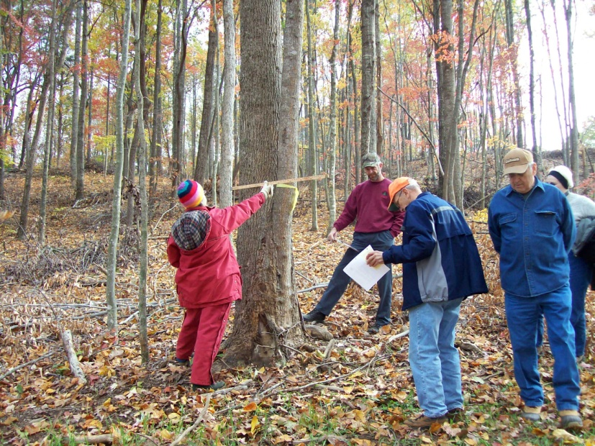
Key Programs
Virginia Forestry Landowner Education
Virginia Master Naturalists
Virginia SHARP Loggers
Urban Forestry
Virginia Wildlife Education Program
Virginia Forest Products
Virginia Geospacial Extension Program

Slide 5
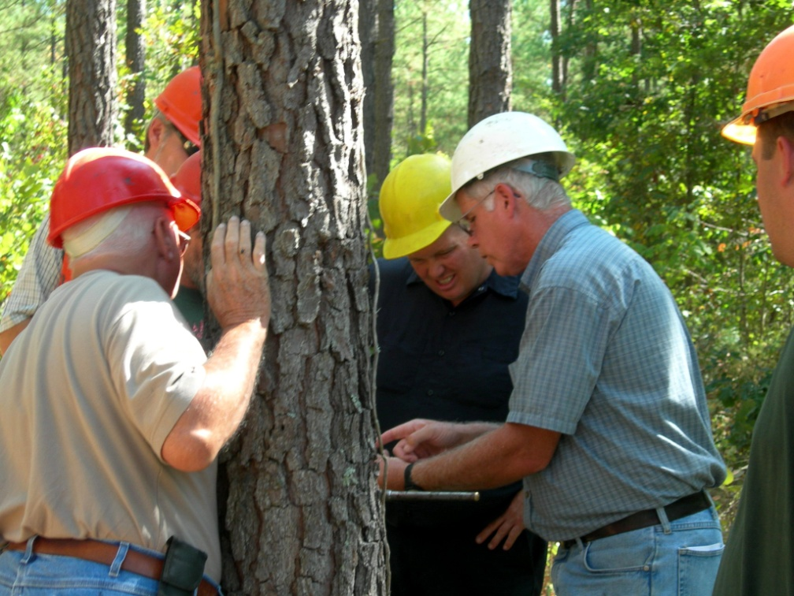
PROGRAM ORGANIZATION
Within the CNRE, 3 departments have Extension Specialists and associates focused on specific educational issues.
Specialists/associates report directly to their respective Department Heads in Fisheries and Wildlife Conservation, FREC, and Sustainable Biomaterials.
Four district forestry and natural resource agents report to District Directors.

Slide 6
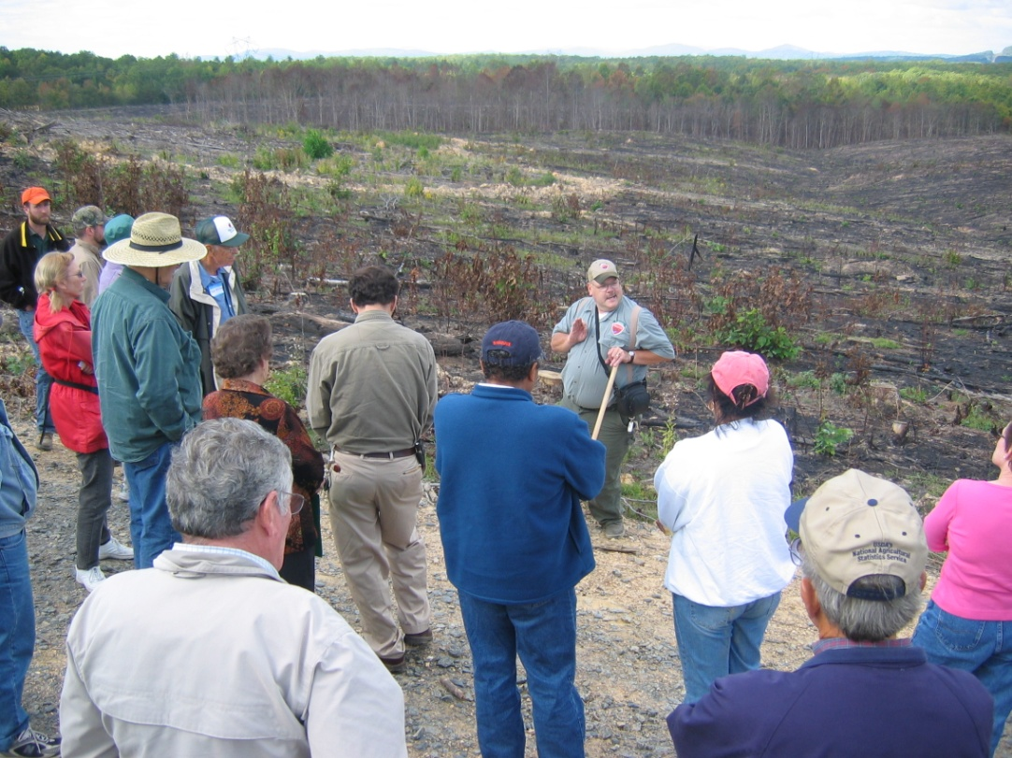
District Natural Resource Agents
Four of the states extension districts have a NR Agent.
They identify and deliver programs for all counties in district.
They work closely with CNRE and other extension specialists.
They work closely with other extension agents in district.

Slide 7
Describe your overall Forestry & Wood Products Extension program.
Number of faculty – 16
  County-based - 5
  Campus-based – 11
  Wood Products - 3
Areas of focus – Landowner education, Logging, Urban forestry, Agroforestry, Wildlife, Geospatial/GIS, Master Naturalist, Primary processing, Secondary procession and business management.
Primarily all hard money funded. Master Naturalist is a combination of soft money/hard money. The specialists occasionally have soft money interns or assistants based on their programs.

Slide 8
What changes have been made in program in the past 5 years?
Program changes in last 5 years
  Expanded Geospacial/Drones
  Expanded Urban Forestry
  Master Naturalist has grown
Changes planned for next 5
  Expand landowner education
New hires?
  None until retirements come
Retirements? (plans to replace)
  None, but yes the will be replaced.

Slide 9
What expertise are you missing that is most often asked for?
Youth education
Fisheries
Nothing in wood products
How do you fulfill those requests now? – Reactive to requests with current faculty. Often, non-extension folks can answer the requests

Slide 10
Top 3 to 5 most common requests (FAQs)
Market information, drying, improved lumber yields, energy conservation
And are you receiving requests for assistance with advanced manufacturing (scanning, optimization, robotics, automation, etc.) on the list? - No
How about Industry 4.0, Internet of Things, Big Data? - No

Slide 11
What are your strengths?
College – Landowner Education, Logger safety, Urban Forestry and Geospatial.
Department – Lumber manufacturing, drying, marketing, lean manufacturing

Slide 12
Describe the 3 biggest challenges facing your program.
As the lumber industry has moved to more automation, we have not kept up with their requirements (I am not sure we are needed in this area).
Who are our new customers – what do they need from extension?
Not doing a good job of promoting our efforts

Slide 13
Describe the 3 biggest opportunities for your program.
Tying our extension efforts into economic development in rural America.
Expanding market opportunities.
Finding a niche within the manufacturing sector (like drying), that there is a constant need for training.
Business planning/management

Slide 14
How has your clientele base changed since the Great Recession?
We have fewer customers with larger production capacity.
They have become highly automated, which we cannot properly serve.
They focus on export markets
The secondary industry has shrunk dramatically (furniture and cabinets)

