Slide 1
Energy, Minerals & Natural Resources Department
Carmen Austin, Las Vegas District
District Forester

Slide 2
Forestry & Wood Products Extension or Outreach/Education program
EMNRD – Forestry and Energy, Conservation & Management Divisions
Wood and biomass utilization, woodland owner assistance
Federal and State funded positions
Collaborative partners: NM Forest Industry Association, Nature Conservancy, Sandoval County Regional Biomass Working Group, Greater Santa Fe Fireshed Coalition, 2-3-2 Cohesive Strategy Partnership, Chama Peak Land Alliance, Greater Rio Grande Watershed Alliance, Greater Ruidoso Area WUI Work Group, Otero Working Group and Grant County Eco-Watershed Working Group
Wood and biomass utilization TA
Federally and privately funded

Slide 3
What changes have been made in program in the past 5 years?
Lacking dedicated biomass and utilization program manager; trouble recruiting and have unfilled vacancies
Council of Western State Foresters Forest Utilization Network
Changes planned for next 5? New hires? Retirements? Election year.
How has your clientele base changes since the Great Recession
NMFIA networks thru Federal Timber Purchasers Committee via Good Neighbor Authority
NMFIA and Tribes/Pueblos – USFS Stewardship Agreements
Nature Conservancy’s Rio Grande Water Fund - 60 charter signatories working to generate sustainable funding
for a 20-year program to restore 600,000 acres in northern NM to ensure water to ABQ
Walatowa wood pellets, Out of the Woods wood pellets, Blanca sawmill north of stateline
Unwilling to take the financial risk: How do I piece the funding together to expand the business?

Slide 4
What expertise are you missing that is most often asked for?
Specialty TA – biochar, wood pellets, sawmill
Funding – equipment, workshops/conferences
Cross-walk funding mechanisms – Federal, State, County
Economic Development – talking their language, i.e. Local Economic Development Act, Industrial Revenue Bonds, Enterprises and Opportunity Zones
Brick and Mortar funding – USDS Rural Development
How do you fill those requests?
Connect-the-dots

Slide 5
Top 3 to 5 most common requests (FAQs)
And are you receiving requests for assistance with advanced manufacturing (scanning, optimization, robotics, automation, etc.) on the list? Equipment supplier provides TA, no change in technology, not enough timber supply to run at optimization
How about Industry 4.0, Internet of Things, Big Data?

Slide 6
What are your strengths?
State funds treatments cross-jurisdictional boundaries in federal lands – Governor’s Watershed Restoration Initiative
Rio Grande Water Fund – building capacity and partnerships and coordinates funding
CFRP – unique to NM, funding to help connect-the-dots
CFLRP – provide consistency of implementation and allowed expansion of utilization i.e. Southwest Jemez, Zuni Mountains
Blanca sawmill Angel – transport timber supply from Tres Piedres and Taos, NM
NMFIA - Forest Workers’ Safety Certification Program significantly reduces workers compensation insurance premiums

Slide 7
Describe the 3 biggest challenges facing your program
FTE Program Manager – active management to utilization
Funding resources
Sustainable forest supply
Network of technical expertise for PMs to turn to and the financial support for that network

Slide 8
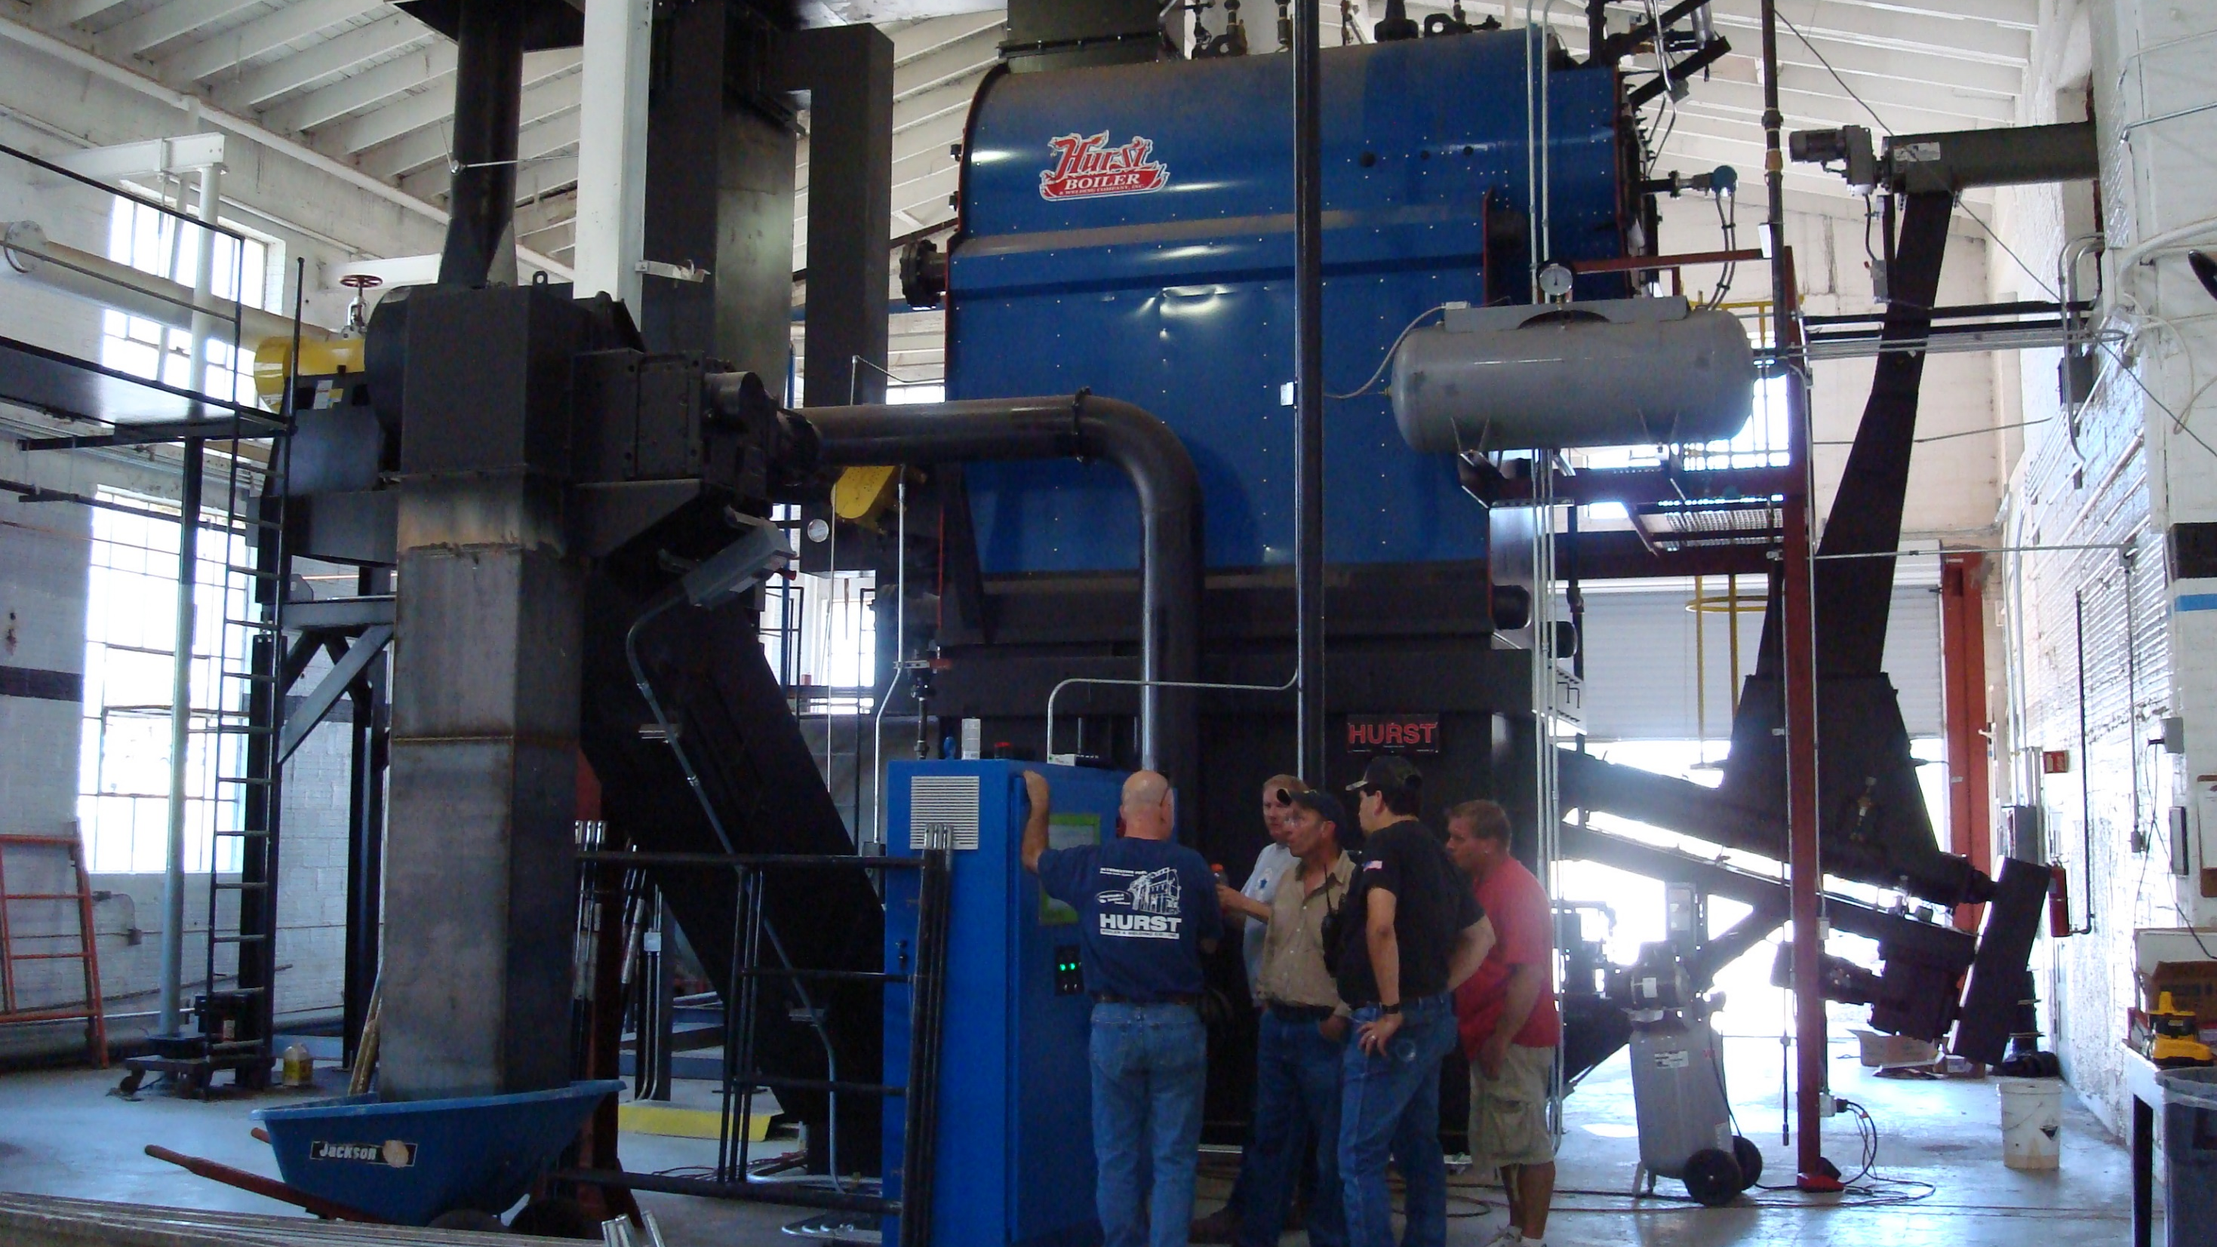

Slide 9
Describe the 3 biggest opportunities for your program
CWSF Forest Utilization Network
Working Groups/Collaborators/Partnerships
Rio Grande Water Fund – Strategy, Path
NEPA on-the-shelf/ready to implement and utilize to make it work at scale needed, ready for investment
Bring together diversified funding sources and focused-attention

