Slide 1
SGSF Environmental Services, Utilization and Marketing (SUM) Committee Overview
National Wood Products Extension Meeting
Madison, WI
September 25, 2018
Clay Altizer – Utilization Forester, NC
Charlie Becker – Utilization & Marketing Manager, VA
Dru Preston – Staff Forester – U & M Division, GA

Slide 2
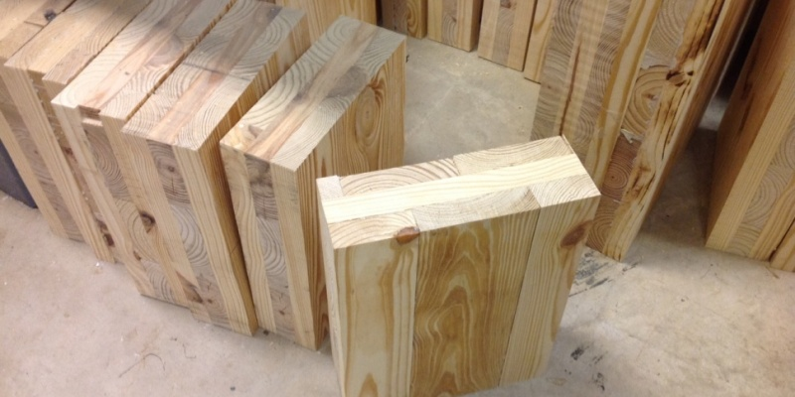
SUM Committee
What SUM Stands For…
Ecosystem Services
Utilization
Marketing

Slide 3
SGSF Environmental Services, Utilization & Marketing
Current Leadership/Structure June 2018 – June 2019
Chair: Barry New (NC)
Chair-elect: Risher Willard (GA)
Past Chair: Ed Dougal (TX)
Secretary: Clay Altizer (NC)
State Forester Liaison: Charlie Morgan (MS)
Communications Committee Liaison: Monica Corbin (FL)

Slide 4
SGSF Environmental Services, Utilization & Marketing
History and Background
2007 – 2013 served as a Task Force
Full SGSF Committee now (one of ten)
Provide leadership for Goal 4 of SGSF Implementation Plan
“The SGSF will provide leadership to enhance both existing and new sustainable forest markets, industries and services that encourage landowners and communities to conserve, enhance and protect forests.”

Slide 5
SGSF Environmental Services, Utilization & Marketing
SUM Charter, Mission/Purpose
To serve as lead in implementing Goal # 4 of the SGSF Implementation Plan and other strategic actions
To share advice, knowledge & expertise
To engage in strategic collaboration on region-wide or multi-state projects
To provide a forum for discussion about opportunities and challenges on the regional or national level
To identify and promote training opportunities for services, utilization and marketing staff

Slide 6
SGSF Environmental Services, Utilization & Marketing
How we operate
Annual leadership terms
Work Plan updated annually
Annual “in-person” meeting (rotates)
Other in-person meetings, trainings, events
TF received dedicated funding in early years
Active in developing and implementing USFS LSR grants – regional or multi-state projects

Slide 7
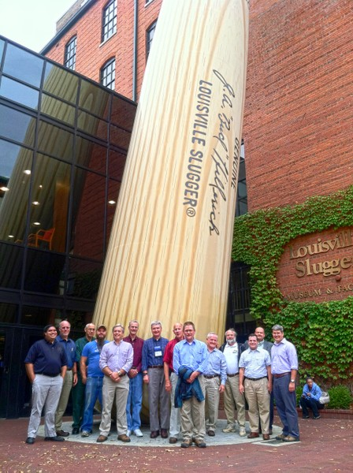
SGSF Environmental Services, Utilization & Marketing

Slide 8
SGSF Environmental Services, Utilization & Marketing
Strengths
SUM Committee has been successful with regional and multi-state projects funded by LSR grants
develop tools
provide training
build overall capacity
nurture partnerships and relationships
address common needs and issues

Slide 9
SGSF Environmental Services, Utilization & Marketing
Challenges
13 states; 7 have a dedicated U&M specialist
4 have someone on staff who handle some aspects of U&M but not primary job
2 states not participating on committee; capacity is unclear/questionable
Combo of state appropriated/grant funded positions
USFS LSR grants are designed to fund defined, time-limited projects, not build or maintain staff capacity
States that lack a basic U&M position are at a disadvantage in participating in regional or multi-state U&M LSR projects
Diversity across the South (Biomass, bio-energy for example)
Timber Product Output (TPO)
Succession planning

Slide 10
SGSF Environmental Services, Utilization & Marketing
Opportunities
Partnership with Southern Regional Extension Forestry has been great
Opportunity to do more to promote urban wood utilization in the South
Opportunity for greater focus on SYP in CLT and other “mass timber” products
Opportunity for state forestry and Extension programs to share and collaborate but not duplicate. Should convey common messages within a state (i.e. – use same economic contribution numbers!)

Slide 11
Common focus areas of state U&M foresters in the South
Success stories…
Industry directories, databases
TPO & FIA
Resource availability/sustainability analysis
International markets & exporting
Economic impact/contribution reporting
Timber price reporting – some states

Slide 12
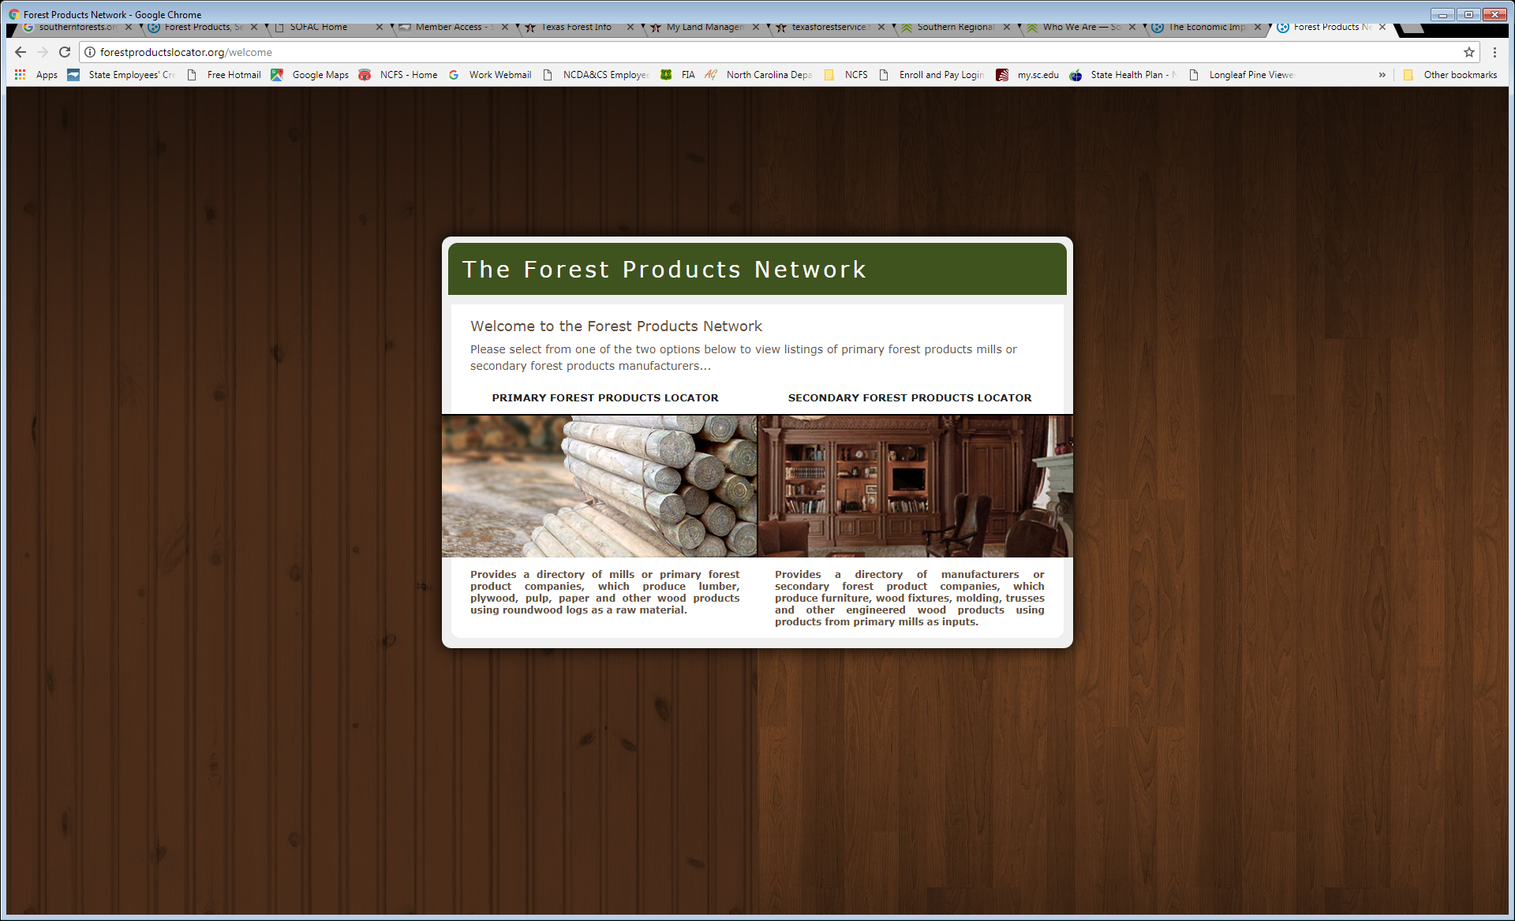
Forestproductslocator.org

Slide 13
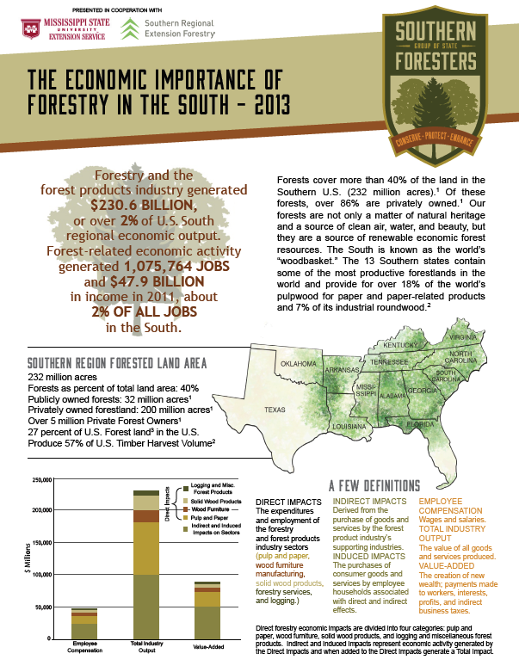
http://www.southernforests.org/services

Slide 14
SGSF Environmental Services, Utilization & Marketing
U&M Capacity…
Federal funding to support one U&M position in each state would pay big dividends!
Work smarter with limited resources. State-level capacity is not expected to increase.

Slide 15
SGSF Environmental Services, Utilization & Marketing
North Carolina – Common Requests
Help me sell my timber!
Lists - Buyers of Standing Timber / CF / Small Woodlot
Stumpage price information
How much is my shade tree worth?
Mill directories
Primary
Secondary
Timber supply assessments, resource availability, competition for resources, site selection assistance, etc.

