Slide 1
College of Forestry Department of Wood Science & Engineering
Scott Leavengood, Director – OR Wood Innovation Center (Extension Specialist)
Eric Hansen, Department Head (former Extension Specialist)

Slide 2
Forestry & Wood Products Extension @ OSU
Faculty
13 county-based
11 campus-based (+ 3 admin)
7 special programs (e.g., Master Naturalist, Oregon NR Ed. Program, etc.)
County-based faculty focused primarily on small woodland owner assistance
Campus-based – wood products (2), timber harvesting, economics, watersheds, Christmas trees, forest health, human dimensions/fire, collaborative conservation, silviculture, Master Woodland Manager
FTE –
1.7 Extension Specialists (hard money)
1.0 TallWood Design Institute director of outreach (soft money; non-Extension)

Slide 3
Recent Changes/Future Plans
Changes planned for next 5
July 1 - hired outreach coordinator for TallWood Design Institute
New hires:
Specialists - timber harvesting, conservation collaboratives
Agents – 5 are new(ish)
Retirements:
Agent in NE Oregon retired (already replaced via reassignment)
Administration:
Loss of 0.5 FTE Extension Specialist (Hansen) – no plans to replace

Slide 4
Change in Clientele Base Since Great Recession
Not much change
Little demand for workshops 2008-2013
Closer relationships w/large companies (Roseburg, Boise, etc.)
Baby boomer retirements – companies seeking employees
Product focus
Working more with flooring (engineered and solid)

Slide 5
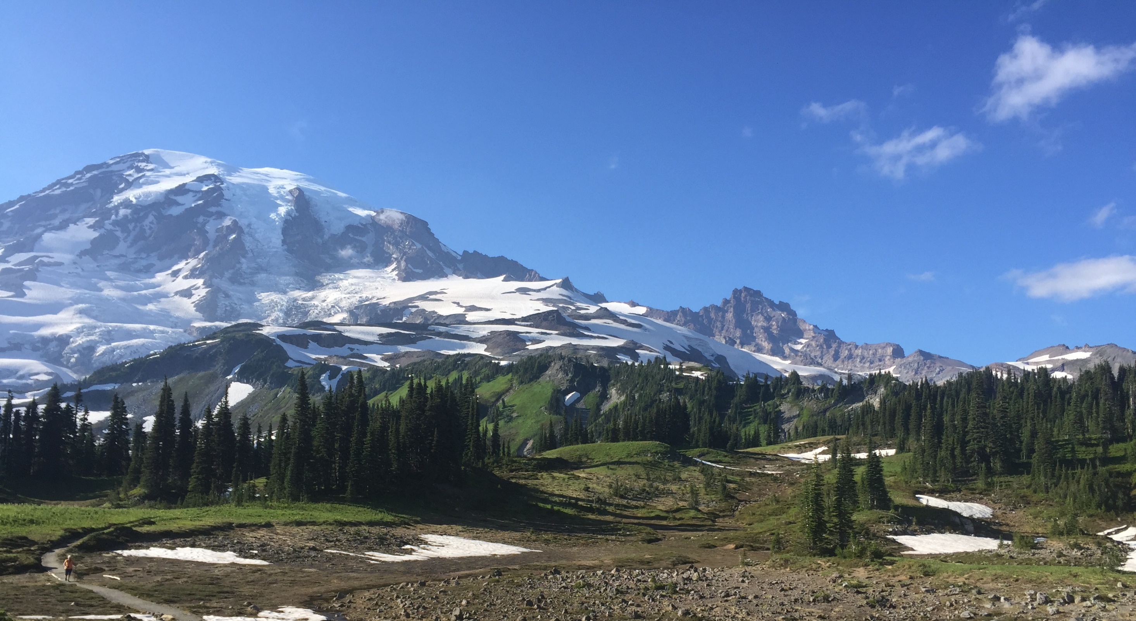
Notes:
This was just going to be like an intermission – so many dull slides in a row with black text on white background – this is Mt. Rainier from a hike in July (we were lost but didn’t care…)

Slide 6
Expertise that is missing:
Lumber drying (VOC emissions in particular)
Pestering our recent retiree…
Burn tests - flame spread ratings
Referrals to Benchmark Intl., HPVA and Western Fire Center
Biomass/bioenergy (e.g., development and testing of pellets, BTUs)
Referrals to Pellet Fuels Institute; some in-house equipment (but limited personnel)
Coatings
Referrals to coatings companies
Acoustics – related to CLT
But - many developments at UO in this area via TDI

Slide 7
Top FAQs
Product testing – routine testing of mechanical & physical properties
Shrink/swell, hardness, bending, durability (soil block), etc.
Non-traditional species – sugar palm, western juniper, ‘Valley’ ponderosa pine, hardwoods
Comparison of species (e.g., western redcedar to Japanese sugi)
‘Is this coating any good?’
Problem solving – checking in hardwood plywood
Wood ID
Advanced Manufacturing, Industry 4.0, etc.?
Clientele likely don’t expect us to know about this
Some emphasis on scanning/optimization and data analysis in QC courses

Slide 8
Strengths
Relationships – we’ve had faculty working w/industry for decades
Importance of networking /industry associations – PWLA, NAWLA, etc.
Relationship -> needs assessment -> educational programming
Breadth and depth
Testing capabilities – large and small scale
Industry directory
Drying, durability, composites – teaching & research faculty that have ‘caught the Extension vision’
Long-standing workshop series
QC, drying, adhesives, management development, plywood
Notes:
Sub-bullet on relationship – needs assessment – educational programming is largely from Chris. We often think of needs assessments as surveys. But by simply showing up at meetings, serving on the board of directors, traveling to far-flung corners of the globe, etc. these people get to know us and trust us such that conducting a needs assessment is merely a matter of being a good listener. From there, the educational programming flows quite naturally.

Slide 9
3 biggest challenges:
Primary processing expertise rapidly dwindling – sawmilling, drying
Hard for researchers to get funding in these areas
Hot topic areas – not directly in our wheelhouse
Mass timber (engineers)
Coatings (vendors/chemists)
Scanning & optimization (vendors/engineers)
Time
‘Good at addition, bad at subtraction’ – shifting attention to hot topic areas results in dilution of focus on core programs
Notes:
Time issue about addition and subtraction is the age-old problem of we never seem to stop doing programs (or let them die a slow death) while always striving to address the topic du jour.

Slide 10
3 biggest opportunities:
Mass Timber/TDI – society is rethinking wood
End of 20th Century – the Spotted Owl and ‘timber wars’
Start of 21st Century – climate change; wood as a carbon sink
The Bioeconomy – helping companies to make the transition
Wood modification technologies
Opportunities related to design
Developing relationships with other industry associations
Notes:
Point for the first bullet is along the lines of this – imagine standing up in front of a group of people in 1994 when we started saying “we should build high-rise structures out of wood (and lots of it) because that would be good for the environment.” You’d have been tarred and feathered or at least ridiculed. My how things have changed… (though some crowds will always be keeping the tar warm).
Actually, I’m thinking the other stuff here is from you!

