Slide 1
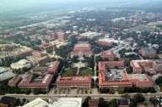
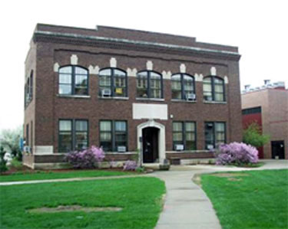
Forest Products Extension at Purdue University The Department of Forestry and Natural Resources, The Wood Research Laboratory West Lafayette, IN Sustainable Biomaterials Process and Products Design (SUBO) https://dev.www.purdue.edu/woodresearch/
Eva Haviarova, Associate Professor &
Rado Gazo, Professor

Slide 2
Hardwood industry contributes $17 billion to IN economy (# 1 in the manufacture of kitchen cabinets, wood office furniture and mobile homes).
Notes:
Rivals to Corn and Soybeans, Economic impact is very high.

Slide 3
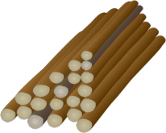
Indiana Forest Facts
Indiana has 4.9 million acres of forestland and 4.7 million acres of timberland.
The area of timberland in Indiana has steadily increased since the 1960's.
Private landowners own approximately 83% of the timberland in Indiana.
Indiana's forests are growing in volume more than 3.3 times the amount being removed.
95% of Indiana's forests are classified as hardwood forest types.
Indiana Wood Products Facts
A payroll of $1.5 billion in 2014.
Provided $4 billion in value-added
$9 billion in total value of shipments to Indiana's economy.
Using Regional Economic Modelling (REMI), figure grows to $16.6 billion.
For every $1 paid to landowners for timber, $48 of value was added in the production of final products.
Every board foot of processed timber adds $51 of economic impact.
Indiana ranks 9th nationally in total lumber production and third in hardwood lumber production.
Industry employs more than 30,000 people and most of the industry concentrated in the southern half of the state.
1967
3.9 Million Acres
1998
4.3 Million Acres
2014
4.7 Million Acres
≅ 3.3
72%
Oak
Hickory
Sources: IDNR; US Census Bureau
www.fnr.purdue.edu/woodresearch

Slide 4
Overall Forestry & Wood Products Extension
Number of faculty:
County-based - (Forest Products 0; Forestry 3)
Campus-based - (Forest Products 2; Forestry 3)
Areas of focus:
Wood Products: hardwood utilization, product development, industry related issues and advancement, opportunities for hardwood CLTs, biomass, workforce development, logs and lumber scanning and grading, lean manufacturing, sustainability issues.
Forestry: Invasive species control; small woodland owner assistance, forest management; white oak regeneration; silvicultural treatments, etc.)
Funding sources (hard vs. soft money positions)
Wood Products: hard
Forestry: hard

Slide 5
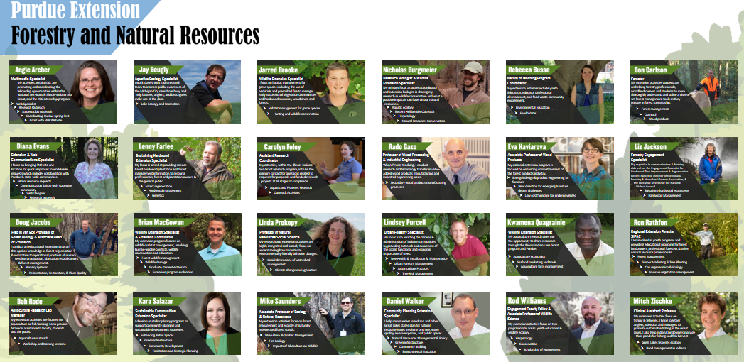

Slide 6
What changes have been made in program in the past 5 years?
Changes planned for next 5:
- We hope to obtain new faculty for forest products area
New hires? No
Retirements? Dr. Hunt, Dr. Eckelman, Dr. Cassens
Plans to replace - No
How has your clientele base changes since the Great Recession
Small and medium companies are disappearing or merging
Small companies do not invest in technology or education
Secondary wood products are using more engineered wood products

Slide 7
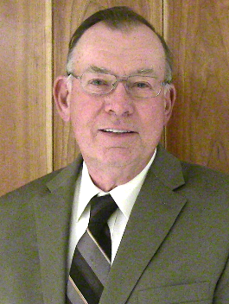
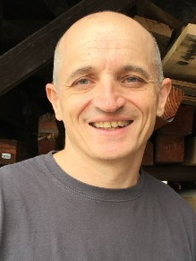
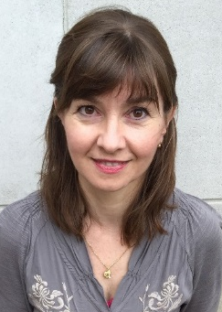
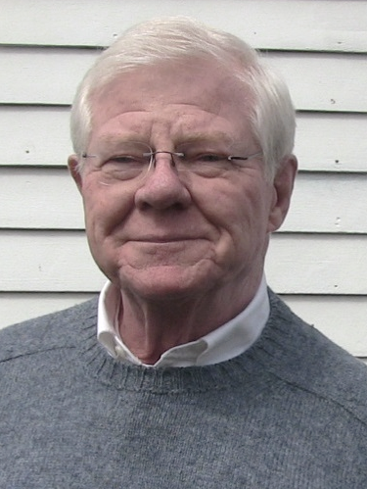
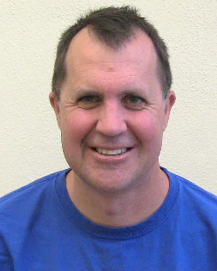
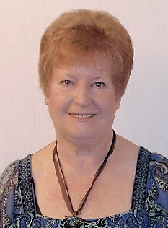
Dr. Dan Cassens Professor
Wood Products Manufacturing
Dr. Rado Gazo Professor
Wood Processing and Industrial Engineering
Dr. Eva Haviarova Associate Professor
Wood Research Engineering
Dr. Carl Eckelman
Professor Emeritus
Wood Research Lab
Dr. Michael Hunt
Professor Emeritus
Wood Research Lab
Betty Sue Barlow
Building Deputy/Secretary
Forest Products Building
Dan Bollock Technician
Wood Research Laboratory

Slide 8
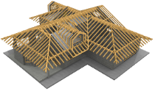
NAME OF PRESENTATION
Wood Research Laboratory
WRL mission: Assist Indiana wood products manufacturers; Develop new knowledge and add value to raw biomaterials; Develop new uses for wood residues; Encourage innovation in wood-based products; Improve wood products engineering and processing technologies.
Company Name
Dr. Rado Gazo Professor
Wood Processing
Dr. Eva Haviarova Associate Professor
Wood Products
Dan Bollock Laboratory
Technician

Slide 9
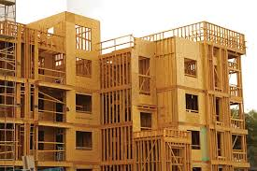
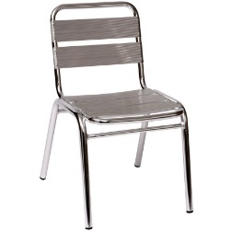
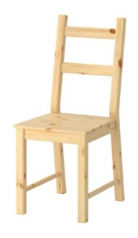
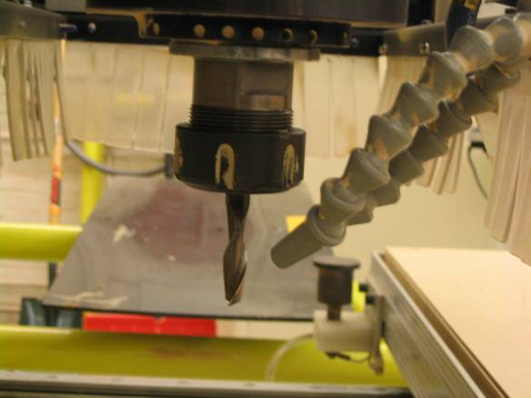
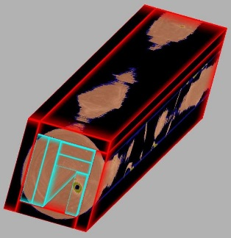
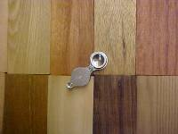
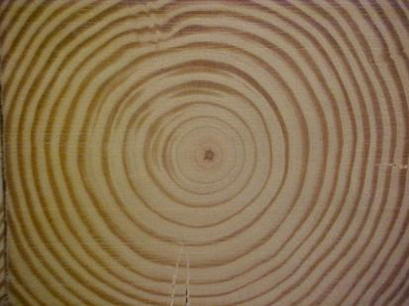
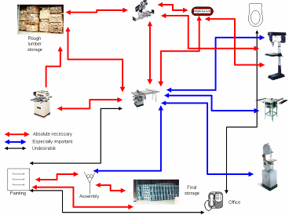
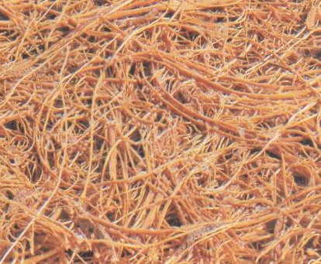
Sustainable Biomaterials Minor Options
Material Knowledge
FNR 31110
FNR 41800
Product Design
FNR 41910
FNR 48410
Technology
& Processing
FNR 30110
FNR 42500
TEACHING

Slide 10
What expertise are you missing that is most often asked for?
How do you fulfill those requests now?
Wood anatomist – retraining for material science and use the help from Forest Products Lab
EWPs expert – use of general knowledge, lit. sources, and refer elsewhere with more complex questions
Gluing and finishing – use of general knowledge, lit. sources, and refer elsewhere with more complex questions
Timber construction – use of general knowledge, lit. sources, and refer elsewhere

Slide 11
Top 3 to 5 most common requests (FAQs) Moisture related issues Wood ID Product development Production and yield improvement
And are you receiving requests for assistance with advanced manufacturing (scanning, optimization, robotics, automation, etc.) on the list? Yes
We have strong expertise in scanning and optimization
How about Industry 4.0, Internet of Things, Big Data?
Just starting to talk about these subjects, it is in the stage or research
FNR is hiring Big Data faculty but in environmental ecology area

Slide 12
What are your strengths?
Long term collaboration with industry
Wealth of information generation in the WRL
Examples of exemplary programs – the ‘flagship’ stuff
Scanning and Optimization
Lumber Grading
Hardwood Value Added
Furniture Manufacturing
Furniture Strength Design
Sustainable Products Development and LCA
School Furniture for Underprivileged

Slide 13
Describe the 3 biggest challenges facing your program
Loss of FTEs
Funding sources
Supplying future workforce

Slide 14
Describe the 3 biggest opportunities for your program
Closeness to wood products industry
Cooperation with industry and associations
Connectivity between research, teaching, and extension

Slide 15
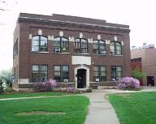
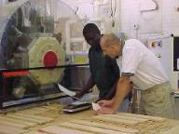
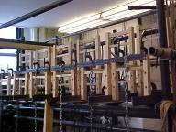
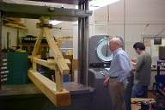
NAME OF PRESENTATION
Wood Research Laboratory
Facilities & Equipment
Fully equipped wood shop with CNC router
Environmentally controlled materials testing lab
Furniture performance testing lab
Microscopy laboratory
Chemistry lab and specimen preparation rooms
Student office with computer laboratory
Woodmizer portable sawmill and light harvesting equipment
Company Name

Slide 16
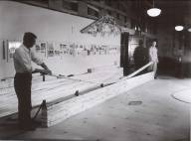
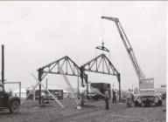
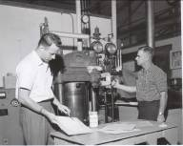
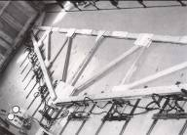
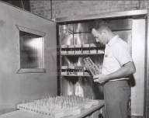
History
Pioneering contributions to wood science
since 1904:
Wood truss design for residential and light-frame industrial buildings.
Evaluation of strength properties of structural lumber using machine stress grading.
Design and evaluation of wood-based composite products as well as development of application for their use.
Product engineering, quality improvement, strength design of furniture and its performance.

Slide 17
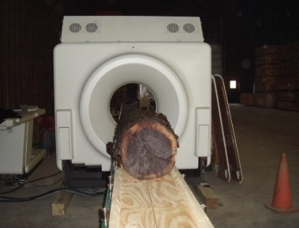
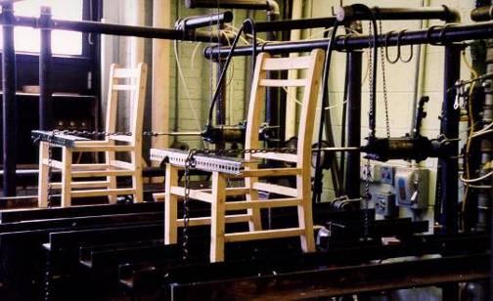
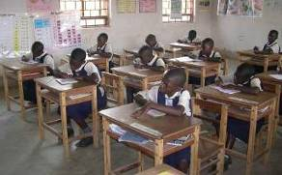
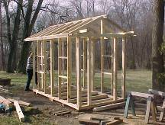
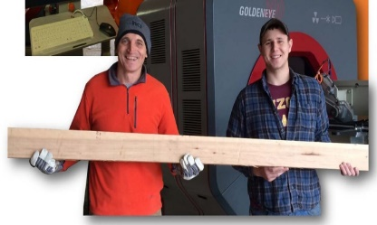
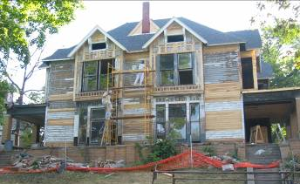
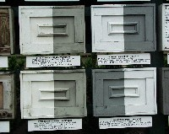
Hardwood Scanning
Furniture Strength Design
LCA on Furniture
School Furniture
Small Diameter Timber Use
https://www.extension.purdue.edu/extmedia/FNR/FNR_270.pdf
Auto Lumber
Grading
Hardwood Value Added
Thin Kerf
Band Mills Mfg.
Yellow Poplar
Utilization
Historical Presentation
XXXXX

Slide 18
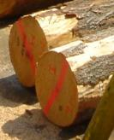
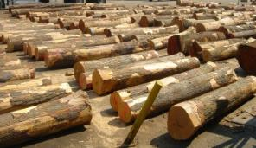
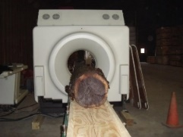
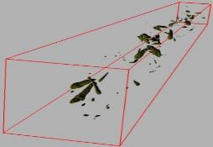
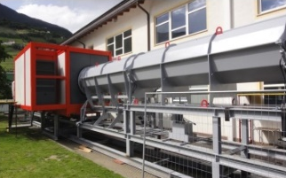
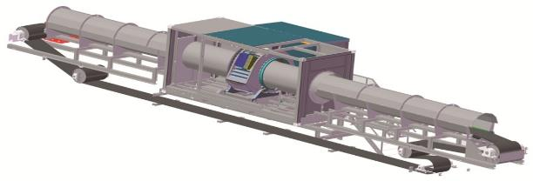
Dr. Rado Gazo
Scientific Problem – Being able to see “inside a tree”
Developed Solution – World’s first CT scanner for hardwood logs and related processing optimization software
Technology Transfer – 6 CT scanners installed in sawmills around the world, including 1 in Indiana

Slide 19
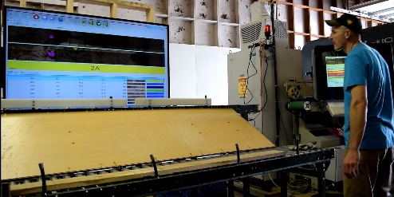
Dr. Rado Gazo
Scientific Problem – Automated Grading of Hardwood Lumber
Developed Solution – World’s first hardwood lumber
grading scanner and related processing optimization software
Technology Transfer – 3 nation-wide demonstration workshops past 3 months. Adoption of technology by industry is on-going.
Logan Wells
Master Student
Wood Products

Slide 20
Dr. Rado Gazo
Scientific Problem – Measuring and Optimizing True Sustainability of Supply Chains.
Developed Solution – A new Sustainability Benchmarking Tool
What you have found so far – A completely new sustainability framework with a deployment plan has been developed. 1 Fortune 500 company (Amazon) and 1 international wood products manufacturer (Starwood) have been invited to become collaboration partners.
Fueled by
Cagatay Tasdemir
PhD. Candidate
Wood Products and
Industrial Engineering
Lean
Philosophy
Triple
Bottom
Line (TBL)
Life
Cycle
Analyses (LCA)

Slide 21
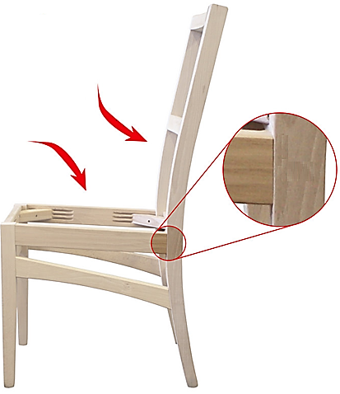
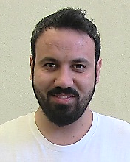
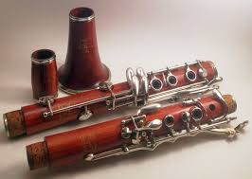
Dr. Eva Haviarova
Projects
Furniture Strength Design - Allowable Design Values
Adding Value to Hardwoods – Innovative uses
Lower Tolerance Limits for Furniture Industry
Wood Mechanics
Furniture Strength Design
Computer Aided Design
Finite Element Analysis
Mesut Uysal
PhD. Candidate
Furniture Strength Design
Alternative Uses for U.S. Hardwoods
Musical Instruments
Furniture Design
International Trade
Yue Zhao
Master Student
Wood Science

Slide 22
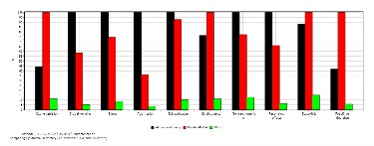
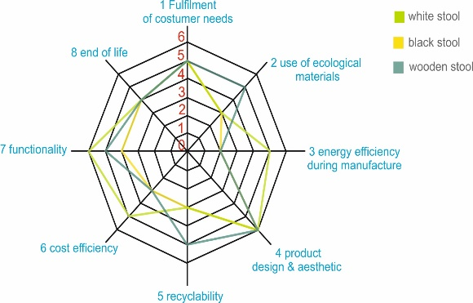
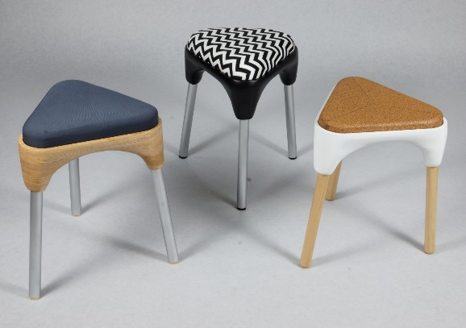
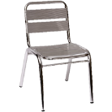
Dr. Eva Haviarova
Projects:
Sustainable Product Development
Product Environmental Footprint – (LCA)
?

Slide 23
Dr. Eva Haviarova
Research Project:
School Furniture for Developing World
Small Diameter Timber Use
Hardwood CLT
School Furniture
Small Diameter Timber Hardwood CLT

